Slide 1
REQUIREMENTS SPECIFICATION FOR REAL-TIME SYSTEMS
Combination of the following approaches for specification of realtime applications:
- Top-down process decomposition or structured analysis.
- Object-oriented approaches.
- Program description languages (PDL) or pseudocode.
- High-level functional specifications that are not further decomposed.
- Ad hoc techniques, including simple natural language and mathematical description, and are always included in virtually every system specification.
There are three general classifications of specification techniques;
- informal
- formal
- semiformal.

Slide 2
REQUIREMENTS SPECIFICATION FOR REAL-TIME SYSTEMS
Formal methods have a rigorous, mathematical basis.
Informal Requirements Specifications cannot be completely translated into a rigorous mathematical notation and associated rules as they have little or no underlying mathematical structure, so they cannot be properly analyzed.
Only counter examples of where the system fails to meet the requirements or where there are conflicts can be searched.
Not good enough for real-time systems where formal substantiation of performance characteristics of requirements is necessary.

Slide 3
REQUIREMENTS SPECIFICATION FOR REAL-TIME SYSTEMS
some contend that Unified Modeling Language (UML) is semiformal because
Statechart is formal
other meta-modeling techniques it employs have a pseudo-mathematical basis.
The proposal for UML 2.0 contains formal components, and there are various attempts to formalize it further.

Slide 4
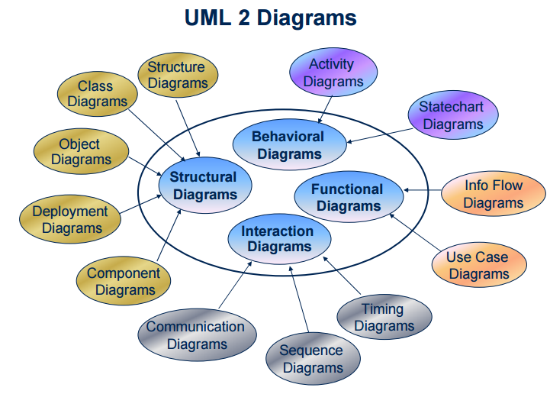
REQUIREMENTS SPECIFICATION FOR REAL-TIME SYSTEMS

Slide 5
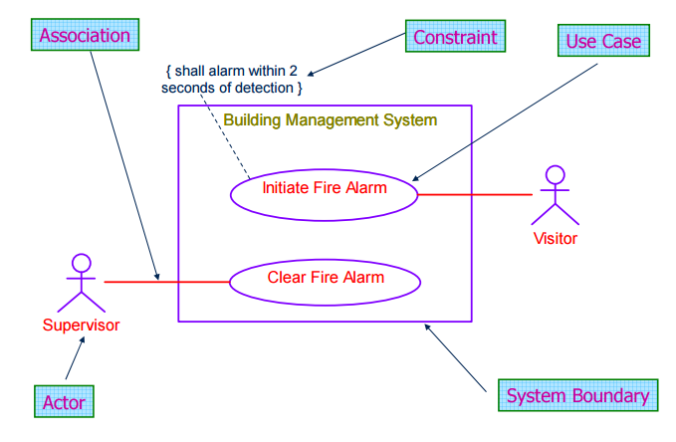
REQUIREMENTS SPECIFICATION FOR REAL-TIME SYSTEMS

Slide 6
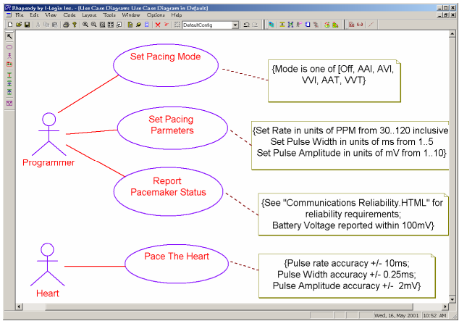
REQUIREMENTS SPECIFICATION FOR REAL-TIME SYSTEMS

Slide 7
FORMAL METHODS IN SOFTWARE SPECIFICATION
Formal methods attempt to improve requirements formulation and expression by the use and extension of existing mathematical approaches such as propositional logic, predicate calculus, and set theory.
There are three general uses for formal methods:
Consistency Checking This is where system behavioral requirements are described using a mathematically based notation.
Model Checking State machines are used to verify whether a given property is satisfied under all conditions.
Theorem Proving Here, axioms of system behavior are used to derive a proof that a system will behave in a given way.

Slide 8
FORMAL METHODS IN SOFTWARE SPECIFICATION
Software Requirements Specification for the nuclear monitoring system:
1.1 If interrupt A arrives, then task B stops executing.
1.2 Task A begins executing upon arrival of interrupt A.
1.3 Either Task A is executing and Task B is not, or Task B is executing and Task A is not, or both are not executing.
These requirements can be formalized by rewriting each in terms of their component propositions, namely:
p: interrupt A arrives
q: task B is executing
r: task A is executing

Slide 9
FORMAL METHODS IN SOFTWARE SPECIFICATION
Then rewriting the requirements using these propositions and logical connectives yields:
1.1 p ⇒￢q
1.2 p ⇒ r
1.3 (r ∧￢q) ∨ (q ∧￢r) ∨ (￢q ∧￢r)

Slide 10
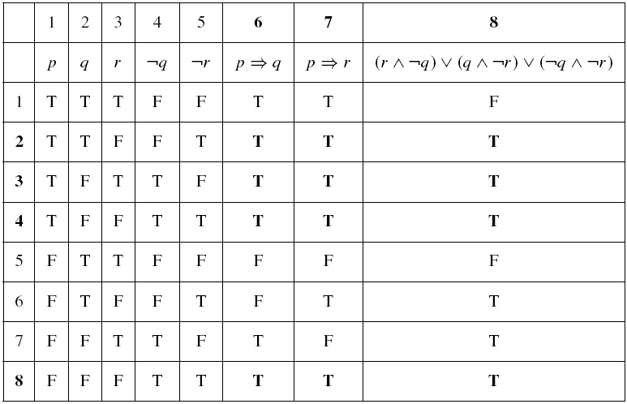
FORMAL METHODS IN SOFTWARE SPECIFICATION

Slide 11
Limitations of Formal Methods
Although formalism is often used in pursuit of absolute correctness and safety, it can guarantee neither.
Formal techniques do not yet offer good ways to reason about alternative designs or architectures.

Slide 12
Z
Introduced in 1982, is a formal specification language that is based on set theory and predicate calculus.
Using the Schema Calculus for system decomposition, the system specification is decomposed in smaller pieces called schemas where both static and dynamic aspects of system behavior are described.
The Z language does not have any support for defining timing constraints so several extensions for time management have emerged.
For example, Z has been integrated with real-time interval logic (RTIL), which provides for an algebraic representation of temporal behavior.

Slide 13
Z
There are other extensions of Z to accommodate the object-oriented approach, which adds formalism for modularity and specification reuse.
These extensions provides for information hiding, inheritance, polymorphism, and instantiation into the Z Schema Calculus.
For example, one extension, Object-Z, includes all the aforementioned extensions and further integrates the concepts of temporal logic, making it suitable for real-time specification.

Slide 14
Finite State Machines
The finite state automaton (FSA), finite state machine (FSM), or state transition diagram (STD) is a formal mathematical model used in the specification and design of a wide range of systems.
FSMs rely on the fact that many systems can be represented by a fixed number of unique states.
The system may change state depending on time or the occurrence of specific events, a fact that is reflected in the automaton.
A finite state machine can be specified in diagrammatic, set-theoretic, and matrix representations.

Slide 15
Finite State Machines
Moore FSA to detect even parity in a stream of bits
State A corresponds to even number of 1s State B corresponds to odd number of 1s
0
0
1
start
A
Even State
B
Odd State
1
 | Current State
Input | A | B
0 | A | B
1 | B | A

Slide 16
Finite State Machines
Mealy FSA for Odd Parity Checker
0/odd
0/even
1/even
A
Odd State
B
Even State
start
1/odd
 | Current State
Input | A | B
0 | A/odd | B/even
1 | B/even | A/odd

Slide 17
Model of an avionics computer for a fighter aircraft:
The avionics system computer can operate in one of five modes:
takeoff (TAK)
navigation (NAV)
navigation/evasive (NAE)
navigation/attack (NAA)
landing (LAN).
The avionics system computer reacts to various signals received from other computers in the aircraft:
mission assignment (MA),
enemy locked-on (LO),
target detected (TD),
mission complete (MC),
enemy evaded (EE),
enemy destroyed (ED).
The initial state is TAK, and the only terminal state is LAN.

Slide 18
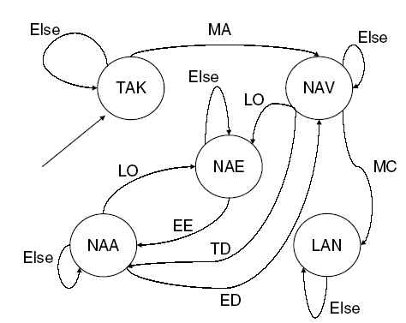
Model of an avionics computer for a fighter aircraft:
The avionics system computer can operate in one of five modes:
takeoff (TAK)
navigation (NAV)
navigation/evasive (NAE)
navigation/attack (NAA)
landing (LAN).
The avionics system computer reacts to various signals received from other computers in the aircraft:
mission assignment (MA),
enemy locked-on (LO),
target detected (TD),
mission complete (MC),
enemy evaded (EE),
enemy destroyed (ED).
The initial state is TAK, and the only terminal state is LAN.

Slide 19
Formally, the finite state machine can be represented mathematically by the five-tuple M = {S, i, T, ∑, δ} where
  S is a finite, non-empty set of states;
  i is the initial state (i is a member of S);
  T is the set of terminal states (T ⊆ S);
  ∑ is an alphabet of symbols or events used to mark transitions;
  δ is a transition function that describes the next state of the machine given the current state, and a symbol from the alphabet (an event).
That is, δ : S × ∑ → S.
In the avionics system example, the set of states,
  S = {TAK, NAV, NAE, NAA, LAN},
  the initial state, i = TAK,
  the set of terminal states is {LAN}, and the alphabet,
  ∑ = {MA, LO, TD, MC, EE, ED}.

Slide 20
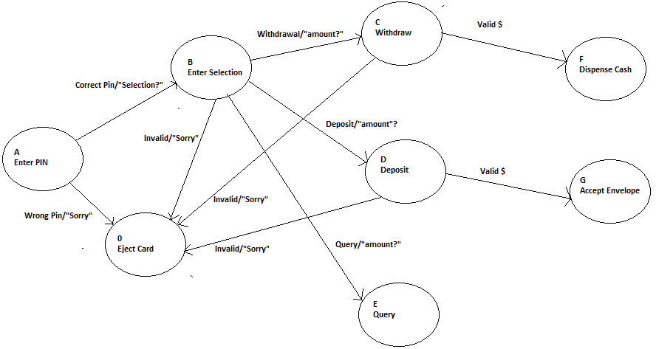
Model of ATM

Slide 21
Finite State Machines
Finite state machines are
Easy to develop
Code can be easily generated using tables to represent the transitions between states.
Unambiguous, since they can be represented with a formal mathematical description.
Concurrency can be depicted by using multiple machines.
Programs based on FSMs can be formally optimized as mathematical techniques for reducing the number of states exist
Major disadvantage of FSMs
The internal aspects, or “insideness” of modules cannot be depicted, there is no way to indicate how functions can be broken down into subfunctions.
Inter task communication for multiple FSMs is difficult to depict.
Depending on the system and alphabet used, the number of states can grow very large.

Slide 22
Statecharts
Statecharts combine finite state machines with data flow diagrams and a feature called broadcast communication in a way that can depict synchronous and asynchronous operations.
Statecharts can be described as
statecharts = FSM + depth + orthogonality + broadcast communication
Here, FSM is a finite state machine, depth represents levels of detail, orthogonality represents the existence of separate tasks, and broadcast communication is a method for allowing different orthogonal processes to react to the same event.
The statechart resembles a finite state machine where each state can contain its own FSM that describes its behavior.

Slide 23
Statecharts
The various components of the statechart:
1. FSM is represented with capital letters or descriptive phrases used to label states.
2. Depth is represented by the insideness of states.
3. Broadcast communications are represented by labeled arrows, in the same way as FSMs.
4. Orthogonality is represented by dashed lines separating states.
5. Symbols a,b, . . . , z represent events that trigger transitions, in the same way that transitions are represented in FSMs.
6. Small letters within parentheses represent conditions that must be true for the transitions to occur.

Slide 24
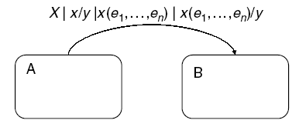
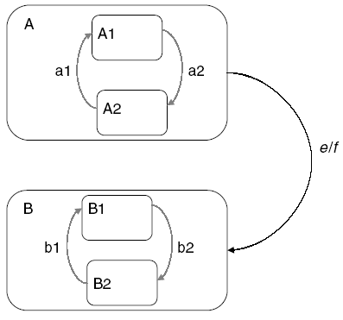
Statecharts

Slide 25
Statecharts
The various components of the statechart:
1. FSM is represented with capital letters or descriptive phrases used to label states.
2. Depth is represented by the insideness of states.
3. Broadcast communications are represented by labeled arrows, in the same way as FSMs.
4. Orthogonality is represented by dashed lines separating states.
5. Symbols a,b, . . . , z represent events that trigger transitions, in the same way that transitions are represented in FSMs.
6. Small letters within parentheses represent conditions that must be true for the transitions to occur.

Slide 26
Statecharts
Statecharts are excellent for representing embedded systems because they can easily depict concurrency while preserving modularity. In addition, the concept of broadcast communication allows for easy intertask.
the statechart combines the best of data flow diagrams and finite state machines.
Commercial products allow graphically design a real-time system using statecharts, perform detailed simulation analysis, and generate Ada or C code. Furthermore Statecharts can be used in conjunction with both structured and object-oriented analysis.

Slide 27
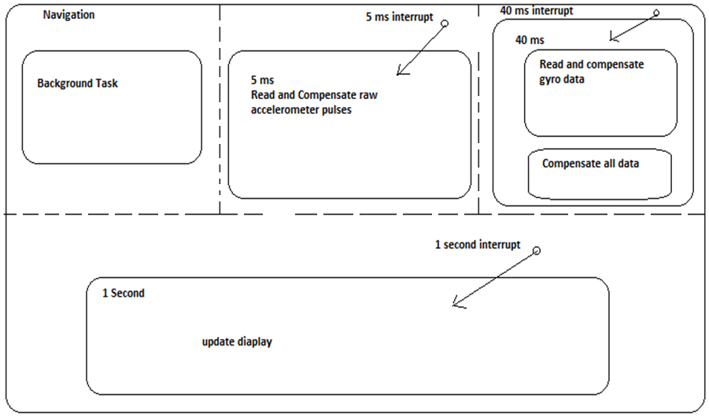
Statecharts: Navigation Subsystem

Slide 28
Petri Nets
Petri nets are another formal method used to specify the operations to be performed in a multiprocessing or multitasking environment.
A series of circular bubbles called “places” are used to represent data stores or processes.
Rectangular boxes are used to represent transitions or operations.
The processes and transitions are labeled with a data count and transition function, respectively, and are connected by unidirectional arcs.

Slide 29
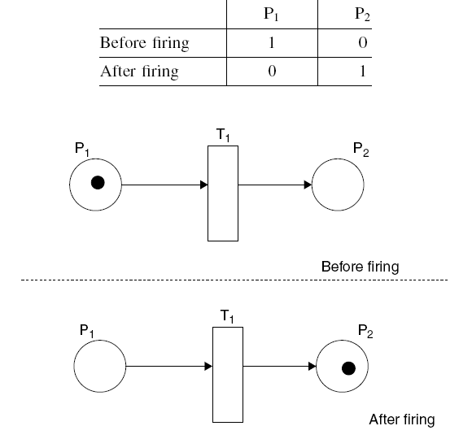
Petri Nets

Slide 30
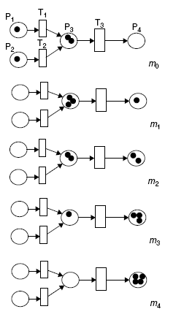
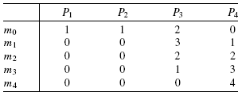
Petri Nets

Slide 31
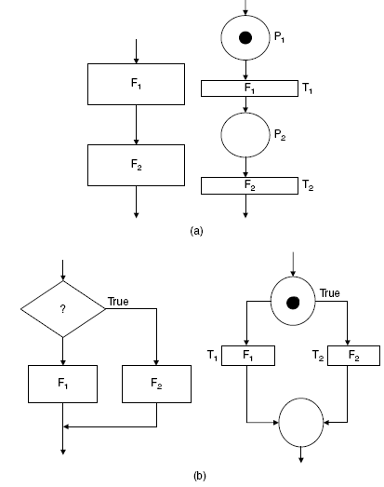
Petri Nets

Slide 32
Petri Nets
Petri nets can be used to model systems and to analyze timing constraints and race conditions.
Petri Nets are excellent for representing multiprocessing and multiprogramming systems
Because they are mathematical in nature, techniques for optimization and formal program proving can be employed.
There are timed Petri nets, which enable synchronization of firings, colored Petri nets, which allow for labeled data to propagate through the net, and even timed-colored Petri nets, which embody both features.

Slide 33
Petri Nets
Hospital patient monitoring system:
Each patient is connected to machines monitoring blood pressure, heart rate, EKG
These machines issue a boolean signal indicating a fail or no fail condition
The result of each of these machines are Ored together to form a signal called ALARM
The ALARM signals for each of these rooms are then Ored together and sent to the nurse’s station

Slide 34
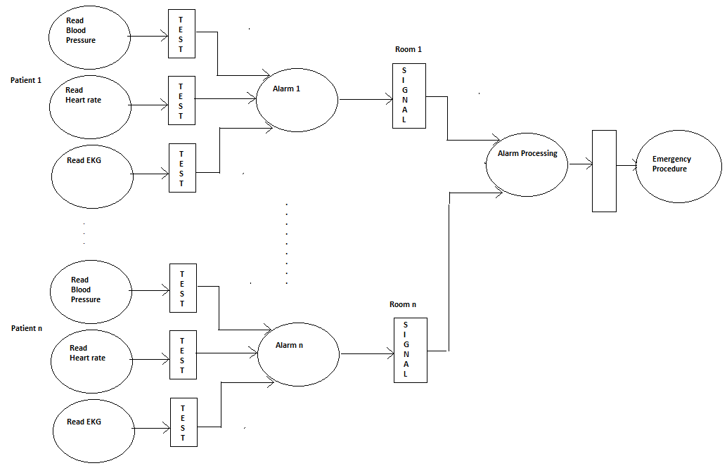
Petri Nets

Slide 35
STRUCTURED ANALYSIS AND DESIGN
SASD methods evolved over 30 years and are widely used in real-time applications, as the techniques are closely associated with the programming languages with which they co-evolved (Fortran and C)
Structured methods appear in many forms, but the de facto standard is Yourdon’s Modern Structured Analysis.

Slide 36
STRUCTURED ANALYSIS AND DESIGN
Structured analysis (SA) is a way to overcome problems of classic analysis using graphical tools and a top-down, functional decomposition method to define system requirements.
SA deals only with aspects of analysis that can be structured: the functional specifications and the user interface.
SA is used to model a system’s context (where inputs come from and where outputs go), processes (what functions the system performs, how the functions interact, how inputs are transformed to outputs), and content (the data the system needs to perform its functions).

Slide 37
STRUCTURED ANALYSIS AND DESIGN
SA seeks to overcome the problems inherent in analysis through:
Maintainability of the target document.
Use of an effective method of partitioning.
Use of graphics.
Building a logical model of the system for the user before implementation.
Reduction of ambiguity and redundancy.

Slide 38
Extensions to SA
Gomaa’s DARTS (design approach for real-time systems).
Originated due to problem in RTSD that it did not take into consideration the characteristics of real time systems which consist of several concurrent tasks.
DARTS solves this problem by providing decomposition principles and for allowing the software designer to proceed from as RTSA specification to a design consisting of concurrent tasks

Slide 39
Extensions to SA
For modeling behavioral characteristics transformation on data flow diagram was made to execute state transition diagram
DARTS was later extended to ADARTS (ADA-based Design Approach for Real time system) AND CODARTS (Concurrent Design Approach for Real time system)

Slide 40
Extensions to SA for specification of real-time systems:
Ward and Mellor extended data flow diagrams by adding edges to represent control and state machines for representing behavior e.g. Teamwork and Software Through Pictures
Control transformations execute state transition diagrams control data transformations by means of event flow
Structured analysis for real-time systems is still based on the notion of the flow of data between successive transformations and provides little support to identify the concurrent processes that must be implemented in a given application.

Slide 41
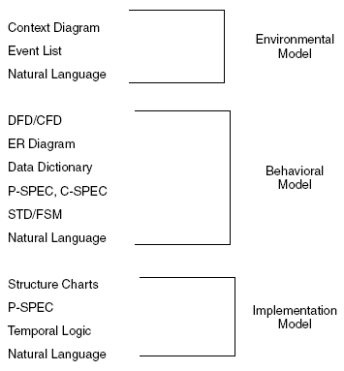
Extensions to SA for specification of real-time systems:
Yourdon’s Modern Structured Analysis uses three viewpoints to describe a system: an environmental model, a behavioral model, and an implementation model.

Slide 42
Extensions to SA for specification of real-time systems:
The environmental model embodies the analysis aspect of SASD and consists of a context diagram and an event list.
The purpose of the environmental model is to model the system at a high level of abstraction.
The behavioral model embodies the design aspect of SASD as a series of data flow diagrams (DFDs), entity relationship diagrams (ERDs), process specifications, state transition diagrams, and a data dictionary.
Using various combinations of these tools, the designer models the processes, functions, and flows of the system in detail
In the implementation model the developer uses a selection of structure charts, natural language, and pseudocode to describe the system to a level that can be readily translated to code.

Slide 43
Extensions to SA for specification of real-time systems:
The target document for SA is called the structured specification that consists of
a system context diagram
an integrated set of data flow diagrams showing the decomposition and interconnectivity of components,
an event list to represent the set of events that drive the system.

Slide 44
Inertial Measurement System (IMU)
Four interrupts in the system, each generated by an external device.
10 ms (an interrupt generated by a clock every 10 ms),
40a ms (an interrupt generated by a clock every 40 ms),
40b ms (another 40 ms interrupt generated by a main computer requesting data from IMU),
1000 ms (an interrupt generated by a clock every second.
Outputs
IMU provides display and diagnostic information to the main computer and to a display. It outputs gyro torquing pulses in order to keep the gyroscopes properly oriented with respect to the inertial reference frame.
Inputs
The IMU takes information from temperature sensors, accelerometers, and position resolvers
Computation
Computes true instantaneous acceleration, velocity, and position with respect to a starting point and orientation (the inertial reference frame).
This information is provided to a main computer onboard the vehicle.
.

Slide 45
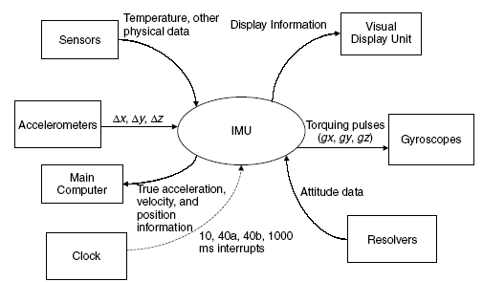
Inertial Measurement System (IMU)
INPUT
OUTPUT
INPUT
OUTPUT
OUTPUT
INPUT
INPUT

Slide 46
Real-Time Extensions of Structured Analysis and Structured Design
SASD methodology is a data-oriented and not a control-oriented approach.
Hatley and Pirbhai extended the SASD method by allowing for the addition of control flow analysis.
arcs made of dashed lines to indicate the flow of control information

Slide 47
Real-Time Extensions of Structured Analysis and Structured Design
solid bars indicating “stored” control commands (control stores), which are left unlabeled
Mealy finite state machines, are used to represent the encapsulated behavior and process activations.

Slide 48
Real-Time Extensions of Structured Analysis and Structured Design
The addition of the new control flows and control stores allow for the creation of a diagram containing only those elements called a control flow diagram (CFD).
These CFDs can be decomposed into C-SPECs (control specifications), which can then be described by a finite state machine.
Although the Hatley-Pirbhai extensions suggest that the CFD and C-SPECs stand alone, the CFD by itself makes little sense. Hence, the CFD and DFD are generally combined

Slide 49
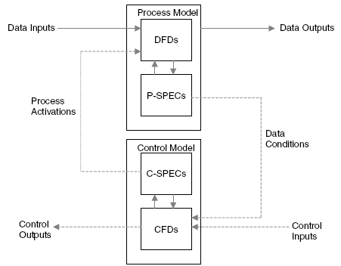
Real-Time Extensions of Structured Analysis and Structured Design

Slide 50
Recommendations on Specification Approach for Real-Time Systems
Challenges in specifying real-time systems:
Mixing of operational and descriptive specifications.
Combining low-level hardware functionality and high-level systems and software functionality in the same functional level.
Omission of timing information.

Slide 51
Recommendations on Specification Approach for Real-Time Systems
No “silver bullet” for software specification and design, each system should be considered on its own merits.
Best practices:
Use consistent modeling approaches and techniques throughout the specification, for example, a top-down decomposition, structured, or object oriented approaches.
Separate operational specification from descriptive behavior.
Use consistent levels of abstraction within models and conformance between levels of refinement across models.
Model nonfunctional requirements as a part of the specification models, in particular, timing properties.
Omit hardware and software assignment in the specification (another aspect of design rather than specification).

Slide 52
THE DESIGN ACTIVITY
Identifying the components of the software design and their interfaces from the Software Requirements Specification.
The principal artifact of this activity is the Software Design Description (SDD).
During the design period, the software architecture must be designed, which involves the following tasks:
  Performing hardware/software trade-off analysis.
  Designing interfaces to external components (hardware, software, and user interfaces). Designing interfaces between components.
  Making the determination between centralized or distributed processing schemes.
  Determining concurrency of execution.
  Designing control strategies.
  Determining data storage, maintenance, and allocation strategy.
  Designing database structures and handling routines.
  Designing the start-up and shutdown processing.

Slide 53
THE DESIGN ACTIVITY
  Designing algorithms and functional processing.
  Designing error processing and error message handling.
  Conducting performance analyses.
  Specifying physical location of components and data.
  Designing any test software identified in test planning.
  Creating documentation for the system including (if applicable):
    Computer System Operator’s Manual
    Software User’s Manual
    Software Programmer’s Manual
  Conducting internal reviews.
  Developing the detailed design for the components identified in the software architecture.
  Developing the test cases and procedures to be used in the formal acceptance testing.
  Documenting the software architecture in the form of the SDD.
  Presenting the design detail information at a formal design review.

Slide 54
Problems with SA/SD in Real-Time Applications
Difficulty in modeling time and events.
For example, concurrency is not easily depicted in this form of SASD.
Problem in context diagram.
Control flows are not easily translated directly into code because they are hardware dependent.
The control flow does not really make sense since there is no connectivity between portions of it, a condition known as “floating.”

Slide 55
Problems with Structured Analysis and Structured Design in Real-Time Applications
Details of the underlying hardware also need to be known for further modeling of Process 1.
  What happens if the hardware changes?
  What if the algorithm or even the sensitivity levels change because of the installation of new hardware?
  In this case the changes would need to propagate into the level 1 DFD for each process, any subsequent levels and, ultimately, into the code.
Making and tracking changes in structured design is fraught with danger.
Any change means that significant amounts of code would need to be rewritten, recompiled, and properly linked with the unchanged code to make the system work.
None of these problems arise using the object-oriented paradigm.

Slide 56
Object-Oriented Design Using the Unified Modeling Language
The UML is widely accepted as the de facto standard language for the specification and design of software-intensive systems using an object-oriented approach.
The UML is a graphical language based upon the premise that any system can be composed of communities of interacting entities and that various aspects of those entities, and their communication can be described using the set of nine diagrams:
Use case, sequence, collaboration, statechart, activity,
Class, object, Component, deployment.

Slide 57
Object-Oriented Design Using the Unified Modeling Language
With respect to real-time systems it is these behavioral models that are of interest.
Use case diagrams document the dialog between external actors and the system under development;
sequence and collaboration diagrams describe interactions between objects;
activity diagrams illustrate the flow of control between objects;
statecharts represent the internal dynamics of active objects.
Some notion of time has been included in the UML through the use of sequence diagrams.

Slide 58
Object-Oriented Design Using the Unified Modeling Language
Activity
Activity diagrams are closely related to the flow chart and are used to show flow of control.
Typically, they are used to model dynamic aspects of a system. Unlike flowcharts, they can model concurrent computational steps and the flow of objects as they move from state to state at different points in the flow of control.
Object Diagram
Object diagrams realize part of the static model of a system and are closely related to class diagrams.
They show the insides of things in the class diagrams and their relationships. Moreover, they are a model or snapshot of the run-time system at a given point in time.

Slide 59
Object-Oriented Design Using the Unified Modeling Language
Class Diagram
During system design the class diagram defines the actual class attributes and methods implemented in an object-oriented programming language.
Design patterns provide guidance on how the defined class attributes, methods, and responsibilities should be assigned to objects.
Collaboration Diagram
Collaboration diagrams show the messages passed between objects through the basic associations between classes.
In essence, they depict the behavior on class diagrams.
The collaboration diagram contains classes, associations, and message flows between classes.

Slide 60
Object-Oriented Design Using the Unified Modeling Language
Component
These diagrams are made up of components, interfaces, and relationships.
Components represent preexiting entities.
Interfaces represent the functionality of components that are directly available to the user.
Relationships represent conceptual relationships between components
Deployment
Deployment diagrams consist of nodes, representing real-world aspects of a system and links that show relationships between nodes.

Slide 61
Object-Oriented Design Using the Unified Modeling Language
Sequence Diagram
Sequence diagrams are composed of three basic elements: objects, links, and messages, which are exactly the same as for the collaboration diagram.
However, the objects shown in a sequence diagram have a lifeline associated with them, which shows a logical time line.
The time line is present whenever the object is active, and is represented graphically as a vertical line with logical time traveling down the line.
The objects for the sequence diagram are shown going horizontally across the page and are shown staggered down the diagram depending on when they are created.

Slide 62
Modeling Time Explicitly
Two object-oriented design methodologies has provision for real-time requirements :
real-time object-oriented modeling (ROOM) and HRT-HOOD
Only HRT-HOOD provides a method for guaranteeing deterministic timing behavior in hard realtime systems.
This is achieved by
eliminating inheritance
introducing a small number of class stereotypes (active, passive, protected, cyclic, and sporadic),
restricting the synchronization mechanism for class operations
The Unified Process Model (UPM) with UML has been used successfully, with a number of extensions. And, as of this writing, UML 2.0, with significant extensions for real-time applications.

Slide 63
Modeling Time in Object-Oriented Systems
Behavioral aspects of the design can be represented by a number of different diagrams in the UML.
Perhaps the most popular choice is to use sequence diagrams.
Other techniques for modeling time outside of the UML include the use of Q models [Motus94] and various temporal logics.

Slide 64
Modeling Time in Object-Oriented Systems
Behavioral aspects of the design can be represented by a number of different diagrams in the UML.
Perhaps the most popular choice is to use sequence diagrams.
Other techniques for modeling time outside of the UML include the use of Q models [Motus94] and various temporal logics.

